Slide 1
Secure Data Hiding in Image Using Steganography
CAPSTONE PROJECT
Presented By: Sk Mizan Humaid
Student Name : Sk Mizan Humaid
College Name & Department : St Thomas’ College of Engineering and Technology & Computer Science Engineering

Slide 2
OUTLINE
Problem Statement
Technology used
Wow factor
End users
Result
Conclusion
Git-hub Link
Future scope

Slide 3
Problem Statement
Traditional steganography tools lack robust integration of password protection and precise data retrieval, risking unauthorized access or data loss. Existing methods often fail to handle variable message lengths securely within standard image formats. This project addresses these gaps by embedding encrypted messages and passwords into images using pixel-channel manipulation, ensuring controlled access and reliable extraction.

Slide 4
Technology used
Python: Core programming language for implementing steganography logic and GUI.
OpenCV (cv2): For reading, modifying, and writing image pixel data.
Tkinter: GUI toolkit for creating the user interface to input messages and passwords.
NumPy: Implicitly used by OpenCV for array-based image manipulation.
Basic Steganography: Pixel-channel manipulation to embed/extract data within RGB values.
File I/O: Handling image files (PNG/JPEG) for lossless data embedding and retrieval.

Slide 5
Wow factors
Password-Protected Steganography: Embeds a password alongside the secret message, ensuring only authorized users can decrypt the data.
Dynamic Data Embedding: Handles variable-length messages and passwords by embedding metadata (e.g., password length) for precise extraction.
Pixel-Channel Manipulation: Uses all three RGB channels of each pixel for efficient data embedding, maximizing image capacity.
Lossless Image Format Support: Saves encrypted images in PNG format to prevent data corruption caused by compression (unlike JPEG).
User-Friendly GUI: Provides an intuitive interface for message encryption and decryption, making it accessible to non-technical users.
Error Handling and Validation: Checks image size compatibility and ensures proper file handling, preventing runtime errors.
Customizable Input Image: Allows users to specify any image file for encryption, enhancing flexibility.
Secure Delimiter System: Uses a unique delimiter (ASCII 255) to separate the message and password during embedding and extraction.

Slide 6
End users
Cybersecurity professionals seeking covert data transfer.
Individuals needing secure communication channels.
Researchers and developers working on data hiding techniques

Slide 7
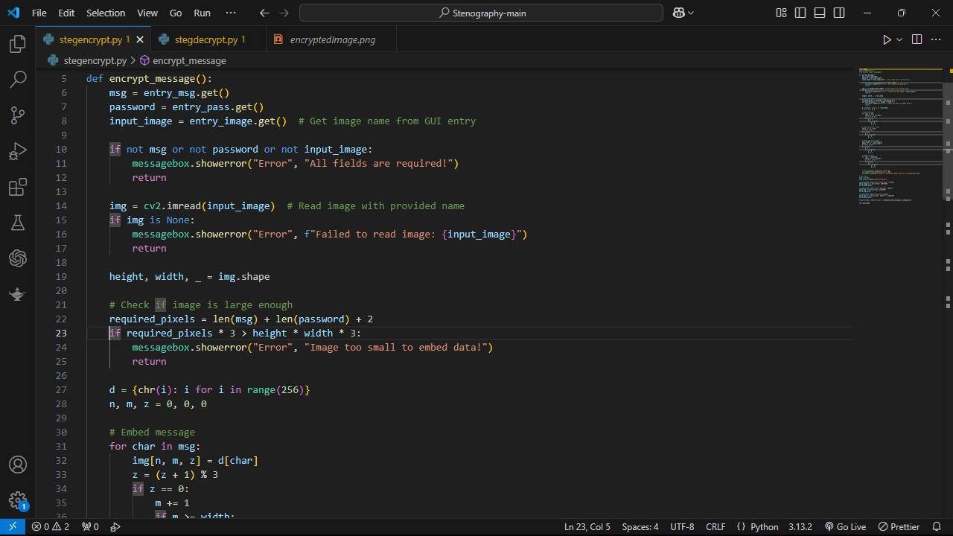
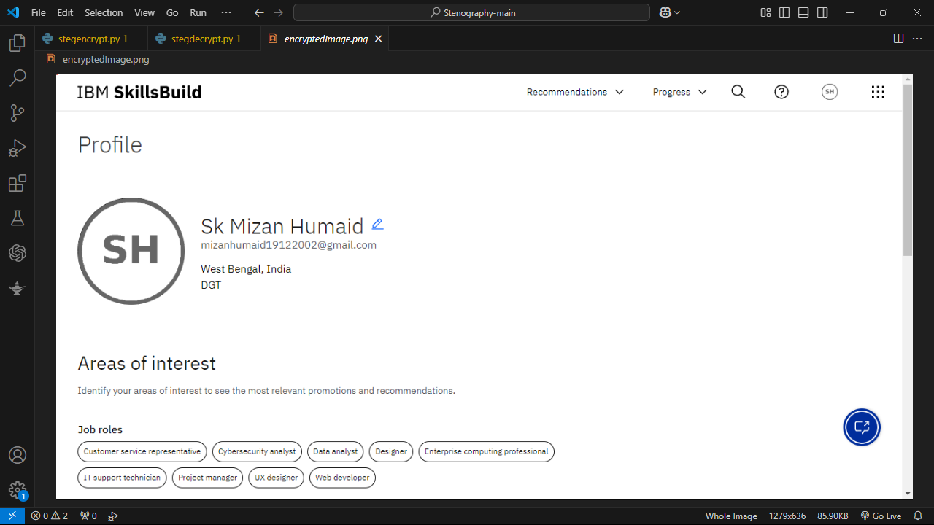

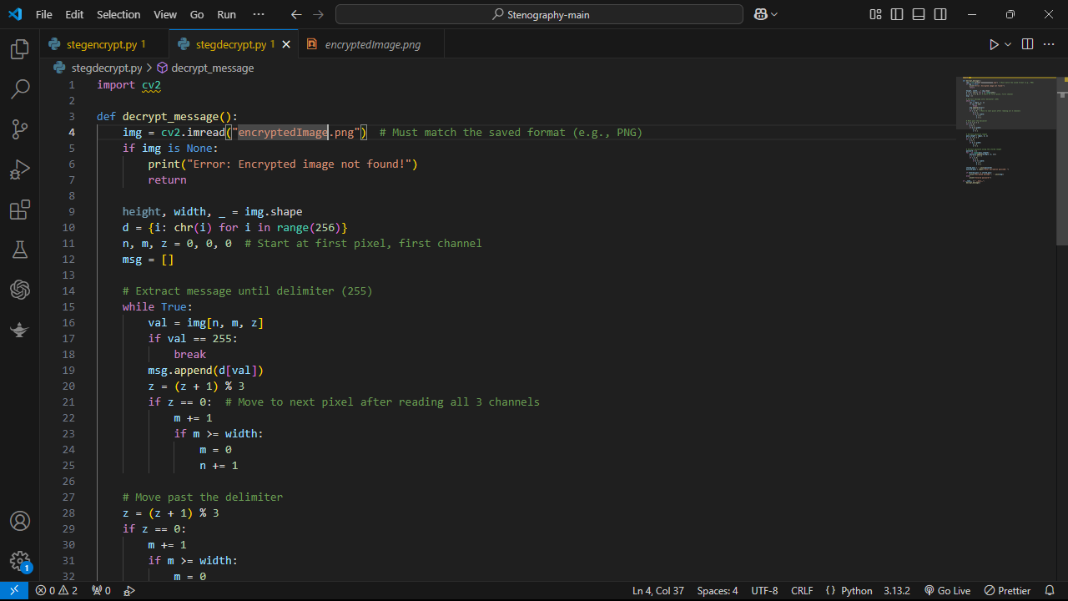
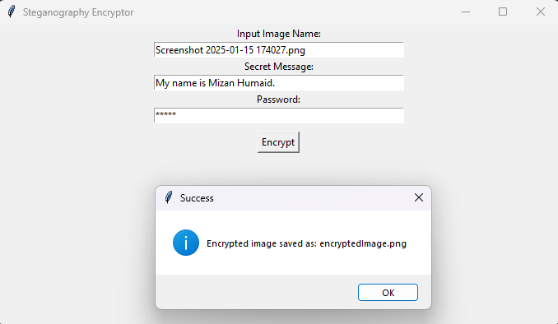
Results
Encryption Program
Encrypted Image
Output 2
Decryption Program
Output 1(Entering data and passcode)

Slide 8
Conclusion
This project effectively demonstrates secure data hiding using image steganography.
Password protection ensures confidentiality and prevents unauthorized access.
Provides a practical and reliable method for covert communication.

Slide 9
GitHub Link
https://github.com/MizanH19/image-steganography.git

Slide 10
Future scope(optional)
Integrate advanced encryption algorithms for enhanced security.
Expand support to multimedia formats like audio and video.
Develop a user-friendly graphical interface (GUI) for easier use.

Slide 11
THANK YOU

